Slide 1
Relay Instructions
Normally Closed
© 2014 John Sefcovic.

Slide 2
Relay Ladder Logic
All Field Devices to this point have been Normally Open switches wired to the Input Module’s termination.
When pressed or actuated, a Normally Open switch provides voltage to the Input Module’s termination, depending on which instruction is used will determine if the condition is TRUE.
To illustrate the use of a Normally Closed Field Device switch wired to an Input Module’s termination, a “three wire” or “holding circuit” will be used.
The principle of Maintained or Momentary input signals will also be discussed.

Slide 3
Relay Ladder Logic
THREE WIRE or HOLDING CIRCUIT
A MAINTAINED signal is an input that remains in the state required for the output to ON for the entire time the output is to be ON.
A MOMENTARY signal is an input that will transition to the state required for the output to be ON, then the input transitions back to its original state.
To keep an output on when a MOMENTARY input transitions back to its original state, a THREE WIRE or HOLDING CIRCUIT with a relay is used.

Slide 4
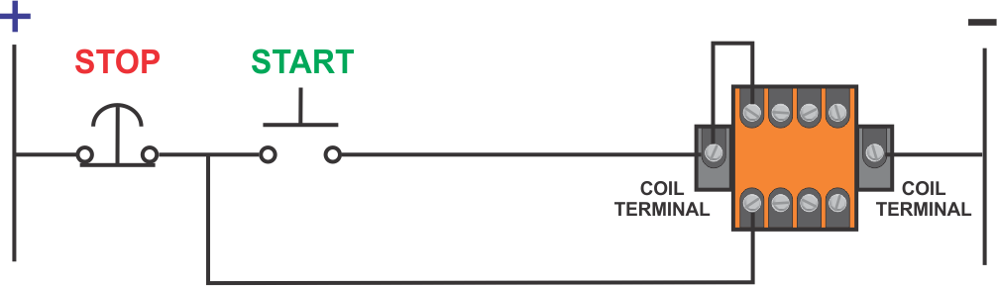
Relay Circuit
THREE WIRE or HOLDING CIRCUIT
The THREE WIRE or HOLDING CIRCUIT uses a spare Normally Open contact on the relay wired to the load.
3
1
2
The remaining terminals on the Orange Relay would be wired to the controlled LOAD.

Slide 5
Relay Circuit
THREE WIRE or HOLDING CIRCUIT
1
The first wire completes the circuit to the relay’s coil when the START pushbutton is pressed.
1

Slide 6
Relay Circuit
THREE WIRE or HOLDING CIRCUIT
2
The second wire branches around the START pushbutton to the relay’s Normally Open contact.
2

Slide 7
Relay Circuit
THREE WIRE or HOLDING CIRCUIT
3
The third wire is connected to the other Normally Open contact to complete a continuity path of the holding circuit.
3

Slide 8
Relay Circuit
THREE WIRE or HOLDING CIRCUIT
After the operator releases the START pushbutton, the THREE WIRE or HOLDING CIRCUIT keeps the LOAD ON until the operator presses the STOP pushbutton interrupting the circuit’s continuity.
3
1
2
The remaining terminals on the Orange Relay would be wired to the controlled LOAD.

Slide 9
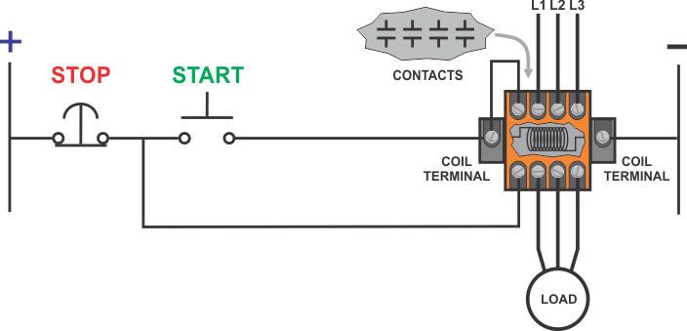
Relay Circuit
THREE WIRE or HOLDING CIRCUIT
This diagram shows the coil inside the relay and the contacts to create the THREE WIRE or HOLDING CIRCUIT and to control a Motor LOAD.

Slide 10
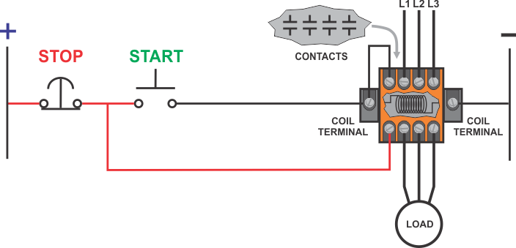
Relay Circuit
THREE WIRE or HOLDING CIRCUIT
When the circuit is energized, continuity flows thru the STOP pushbutton to one CONTACT on the relay.

Slide 11
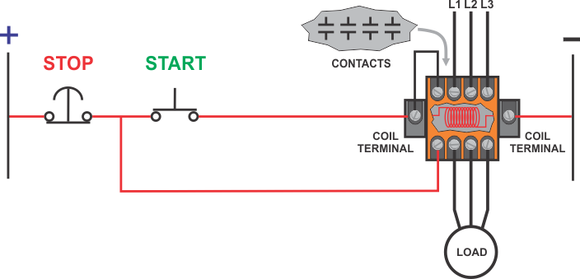
Relay Circuit
THREE WIRE or HOLDING CIRCUIT
When the operator presses the START pushbutton, the continuity flows to the COIL.

Slide 12
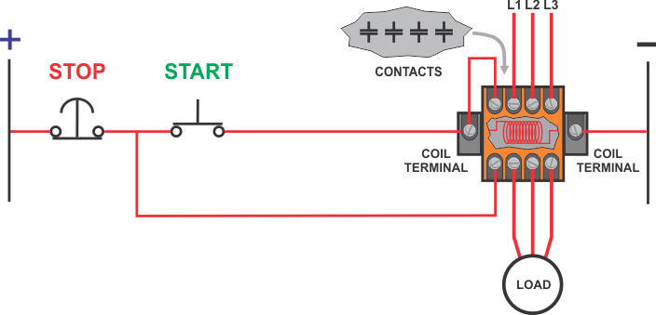
Relay Circuit
THREE WIRE or HOLDING CIRCUIT
This causes the CONTACTS to MAKE to energize the LOAD ON and completes the THREE WIRE or HOLDING CIRCUIT.

Slide 13
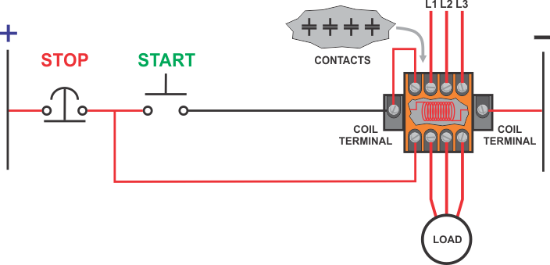
Relay Circuit
THREE WIRE or HOLDING CIRCUIT
After the operator releases the START pushbutton, the THREE WIRE or HOLDING CIRCUIT keeps the LOAD.

Slide 14

Relay Circuit
THREE WIRE or HOLDING CIRCUIT
When the operator presses the STOP pushbutton interrupting the circuit’s continuity to the COIL. The COIL is de-energized and all the contacts open to BREAKS the HOLDING CIRCUIT turns OFF the LOAD.

Slide 15
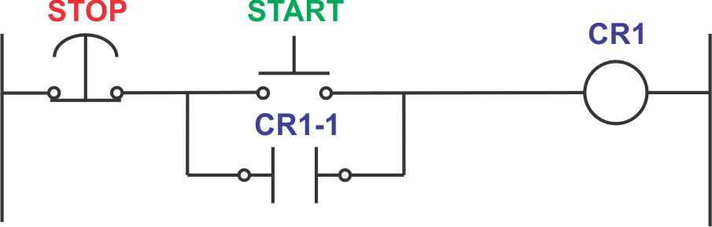
Relay Ladder Logic
THREE WIRE or HOLDING CIRCUIT
The THREE WIRE or HOLDING CIRCUIT allows the output to remain ON when the input condition that make the rung true is MOMENTARY.
The term HOLDING CIRCUIT will be used on these slides.
The Holding Circuit is shown as schematic circuit drawing below.

Slide 16
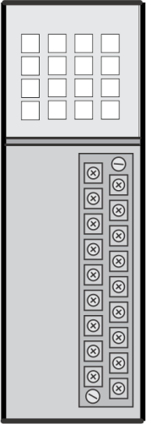



Relay Ladder Logic
HOLDING CIRCUIT WITH PLC
For the PLC, the START and STOP pushbuttons are wired to the Input Module. The relay CR1 is wired to the Output Module.
+
START
+
STOP
CR1
-
-

Slide 17
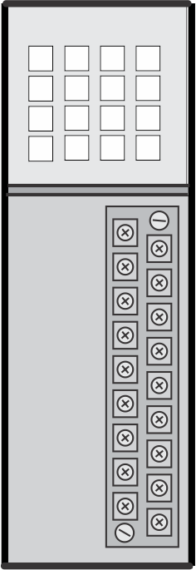
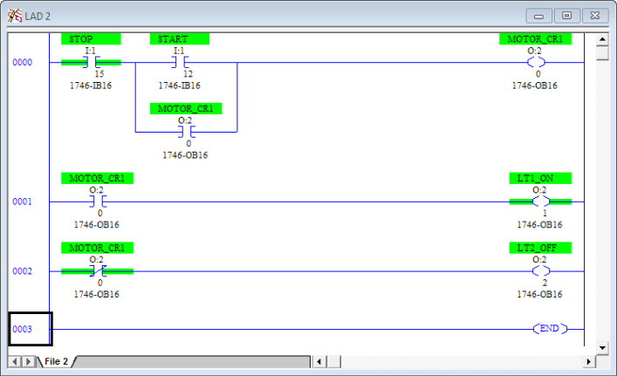
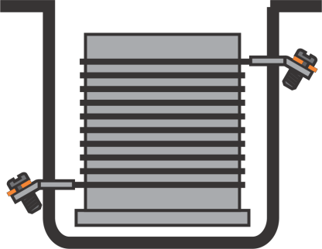
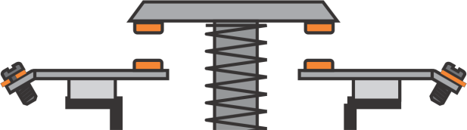
Relay Ladder Logic
The PLC relates to an electromechanical relay in that:
The Input Module of the PLC acts as the Coil of the relay,
The PLC program Input Instruction acts as the Contacts of the relay.

Slide 18
Relay Ladder Logic
For these instruction statements to be TRUE:
-] [- = VOLTAGE = ON = LOGIC '1' = SET
-] \ [- = NO VOLTAGE = OFF = LOGIC '0' = RESET

Slide 19
Relay Ladder Logic
An input instruction symbol in the ladder logic program reflects the status, OPEN or CLOSED, of the input field device.
A program symbol interprets the status of the instruction referenced to an TAG address for a TRUE condition.
The program instruction does not represent the actual input device.
THE PROGRAM INSTRUCTION REPRESENTS THE STATUS OF THE CONTACTS OF THE FIELD INPUT DEVICE WIRED TO THE TERMINAL OF THE INPUT MODULE.

Slide 20
Relay Ladder Logic
A different way to illustrate when the instruction statements to be TRUE:
EXAMINE IN CLOSED
-] [- = INPUT FIELD DEVICE CONTACT’S ARE CLOSED
-] [- = VOLTAGE = ON = LOGIC '1' = SET
EXAMINE IN OPEN
-] \ [- = INPUT FIELD DEVICE CONTACT’S ARE OPENED
-] \ [- = NO VOLTAGE = OFF = LOGIC '0' = RESET
Examine In Closed XIC and Examine In Open XIO is the terminology for the Studio 5000 instructions.

Slide 21
Relay Ladder Logic
HOLDING CIRCUIT WITH PLC
For the PLC, the START pushbutton is wired Normally Opened and STOP pushbutton is wired Normally Closed.
+
START
+
STOP
CR1
-
-
To turn ON the relay CR1, the:
START pushbutton is pressed (actuated) making the contacts.
STOP pushbutton is NOT pressed (unactuated) and the contacts are made.

Slide 22
Relay Ladder Logic
PROGRAMMING NORMALLY CLOSED DEVICE
Programming a NORMALLY CLOSED INPUT FIELD DEVICE:
To program a NORMALLY CLOSED INPUT FIELD DEVICE to act normally closed in the program, it must be programmed with the -] [- symbol.
Remember this applies to NORMALLY CLOSED INPUT FIELD DEVICES only!

Slide 23
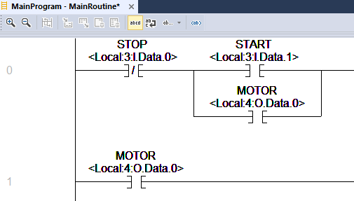

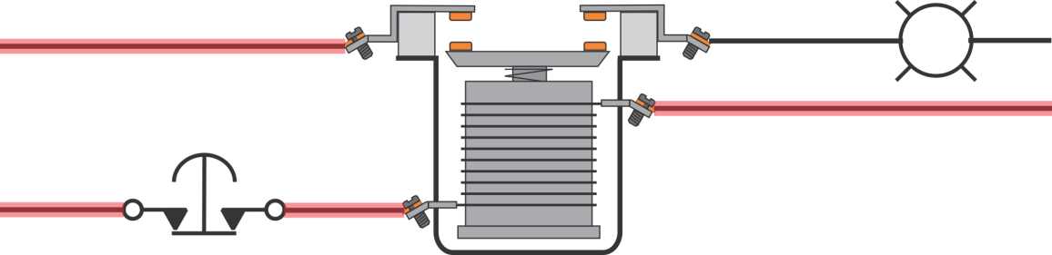
Relay Ladder Logic
PROGRAMMING NORMALLY CLOSED DEVICE
If the equivalent of a Normally Closed Relay is used as the Stop in the program’s Stop-Start circuit, then the instruction does not allow continuity for the motor to be energized.
+
START
STOP
-
Normally Closed Relay

Slide 24
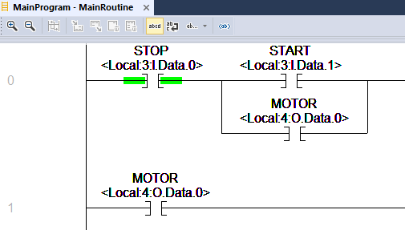
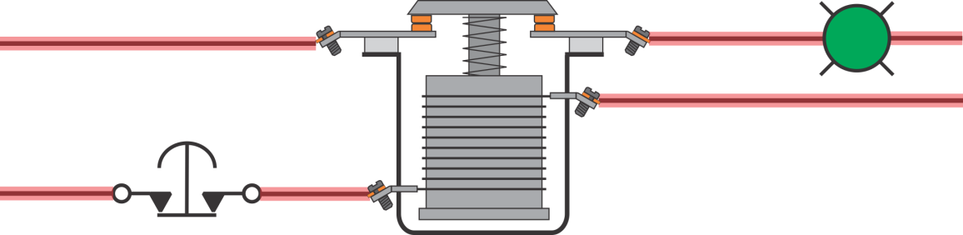
Relay Ladder Logic
PROGRAMMING NORMALLY CLOSED DEVICE
If the equivalent of a Normally Opened Relay is used as the Stop in the program’s Stop-Start circuit, then the instruction does allow continuity for the motor to be energized.
Remember, the Stop pushbutton is not pressed when the motor is on.
+
START
STOP
-
Normally Open Relay

Slide 25



Relay Ladder Logic
To create or interpret a ladder logic program:
Understand the process or machine to be controlled.
What Output Field Devices changes state due to the Field Input Devices change in state?
To determine the input instruction:
What is the function of the input field device?
How is the input field device wired?
What is the state of the field device’s contacts at the time the instruction is to be TRUE?

Slide 26
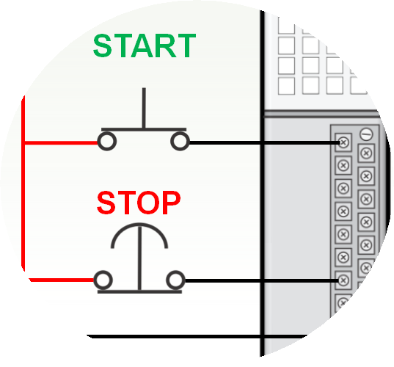

Relay Ladder Logic
PROGRAMMING NORMALLY CLOSED DEVICE
At the time CR1 output is to be TRUE, what is the state of the Field Input Devices contacts controlling the output action?
+
START
STOP
-

Slide 27
Relay Ladder Logic
PROGRAMMING NORMALLY CLOSED DEVICE
At the time CR1 output is to be TRUE:
START pushbutton is pressed (actuated) making the contacts, the contacts are CLOSED.
STOP pushbutton is NOT pressed (unactuated) and the contacts are made, the contacts are CLOSED.

Slide 28
Relay Ladder Logic
PROGRAMMING NORMALLY CLOSED DEVICE
At the time CR1 output is to be TRUE:
START instruction uses the -] [- because the Normally Open pushbutton is pressed.
STOP instruction uses the -] [- because the Normally Closed pushbutton is NOT pressed.

